Slide 1
2020 Friedman award for scholars in health
Info session for applicants
Natalie Thorson, graduate awards coordinator

Slide 2
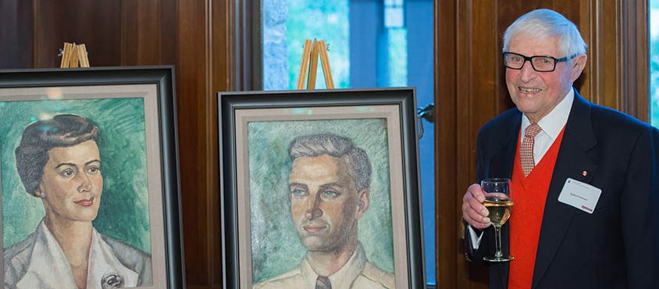
History of the Award: Constance Livingstone & Sydney Friedman
Two of the first appointments to UBC’s Faculty of Medicine, which was founded in 1950.
Established the Department of Anatomy, which was chaired by Sydney Friedman from 1950-1981.
Together published more than 200 papers. Constance Friedman passed away in June 2011 and Sydney Friedman passed away in February 2015.
The Foundation supports the Friedman Award for Scholars in Health and the Freidman Travel Award (for Medical Undergraduate Students).
3.3 million endowment to support these programs given in 2016, and another 6 million endowment given in 2017.

Slide 3
The Goal and Mission of the Friedman Award for Scholars in Health
The Friedmans believed that a well-rounded and transformative education includes learning from different perspectives and cultures.
Goal: To provide funding to graduate students or medical residents so that they can pursue a learning opportunity to further their career or to bring new perspectives to the education they have already received.
Mission: To extend the global reach of UBC graduate students and UBC medical residents and enrich our scholarly community by providing opportunities for our future scholars in the health sciences to learn from global experts in their respective fields.

Slide 4
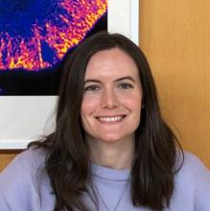
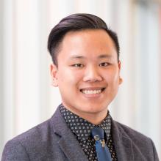
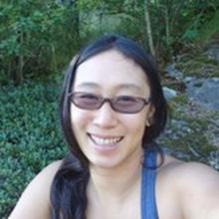
Past Awardees - 2019
2019 Friedman Scholar Madison Bolger-Munro is studying the contribution of mechanical cues at the immune synapse to the B cell immune response at the Institut Curie
(France)
2019 Friedman Scholar Henry Lu is focusing on developing a diagnostic tool for rare immune system disorders called the CBM-opathies at the National Institutes of Health (USA)
2019 Friedman Scholar Maggie Woo Kinshella is undertaking a literature review of maternal nutrition in sub-Saharan Africa (UK / Gambia / Kenya / Mozambique)

Slide 5
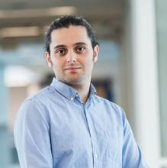
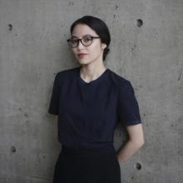
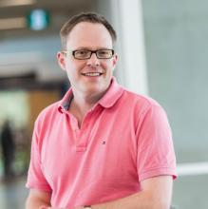
Past Awardees - 2018
2018 Friedman Scholar Hooman Esfandiari is developing VR technology uses for spinal procedures
at Ludwig Maximilian University of Munich and the Technical University of Munich (Germany)
2018 Friedman Scholar Raquel Baldwinson is studying Global Health and the Rhetoric of Interdisciplinarity as a Visiting Fellow at Harvard
(USA / Canada / Rwanda)
2018 Friedman Scholar Andrew Perrin is a medical resident studying how antipsychotic medications impact hippocampal neurogenesis at King’s College, London (UK)

Slide 6
Past awardees have come from a variety of fields, including:
English
Population and Public Health
Microbiology and Immunology
Medical Genetics
Experimental Medicine
Chemistry
Psychology
Health Sciences
Biomedical Engineering

Slide 7
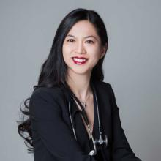
Profile of 2018 recipient Christina Luong
Department: Medicine, Cardiology
Dates of funded opportunity: July 1, 2018, until June 30, 2019
Location: Rochester, Minnesota at the Mayo Clinic
Description: Clinical training in echocardiography with a clinical and research focus on stress echocardiography. Stress echo is a specialized test that evaluates cardiac structure and function during physiologic stress.
Funds used for: Living expenses

Slide 8
Profile of 2018 recipient Christina Luong
Highlights:
Experience of working within a world-class health system with a focus on patient-centered care and excellence in echocardiography.
Opportunity to work with world leaders in the field of echocardiography (Guideline writers and authorities in the field)
Clinical volumes for specialized testing (stress echo) that are 10x higher than available locally
Getting to know the culture of the Midwest
Any tips for future Friedman applicants?
Consider the institution that will allow you the best clinical training or research environment for your field of interest. This is truly an opportunity to seek out world-class training or research experience.
This scholarship afforded the opportunity to obtain expertise that would benefit British Columbians and allowed me to grow as a clinician

Slide 9
Overview of the Application Process

Slide 10
Key Details
Value | Up to $50,000 each will be awarded for six or more months of study. The amount of the award will be at the discretion of the adjudication committee.
Duration | Six or more months of study
Application Deadline | March 13, 2020 at 3:59pm PST

Slide 11
Eligibility - Applicant
Canadians, permanent residents and international students are eligible
Open to Masters and Doctoral students, Medical Residents
Open to applicants studying/researching in the area of health. “Health” is interpreted very broadly, and includes health promotion and disease prevention, mental health research, laboratory sciences etc.
The applicant does not need to be studying in a Health degree. Past award winners have included a PhD candidate in English.

Slide 12
Eligibility – Applicant (cont’d)
Must be a current student/medical resident at UBC as of the application deadline (March 13) – future UBC students starting at UBC later in 2020 are not eligible to apply

Slide 13
Eligibility - Opportunity
Friedman Scholars are expected to travel to other areas of the world to seek new perspectives, learn from experts in their fields and be exposed to different cultures. Applicants carry out scholarly work, gain new knowledge and perspectives in the field of study, and absorb the scholarly culture of the host institution
Acceptable host organizations or groups may include:
Universities
Research centres
NGOs
Private sector companies
Government agencies

Slide 14
Eligibility – Opportunity (cont’d)
Travel must be outside of British Columbia, Alberta, Saskatchewan and Manitoba.
Travel must be for a minimum of 6 months. The travel may be over a longer period (e.g., one year) if circumstances merit it. Note: remote work from Vancouver would not count as part of the minimum six months period.
Travel must begin no earlier than June 1 of the application year and no later than April 30 of the following year.

Slide 15
Eligibility – Budget Expenses
Funds received from this award are to be used for expenses related to the opportunity. These may include: travel expenses (airfare, visas, health insurance, etc.), living expenses (rent, groceries, etc.), fees assessed for related educational endeavours.
Other kinds of research or project-related expenses should include a justification.
The funds may not be used for expenses already incurred or for UBC tuition. None of the funds shall be used to pay down or reduce current or past educational debt, to pay a personal stipend for the learner, or to pay UBC tuition.

Slide 16
Evaluation Criteria
Student/medical resident’s past accomplishments and future promise
The nature and quality of the learning opportunity
The potential impact of the learning/work opportunity on the field of health
Full details on the evaluation criteria are on our website: https://www.grad.ubc.ca/awards/friedman-award-scholars-health

Slide 17
Application Requirements
Application form
Outline of the educational opportunity (4 pages max)
Description of key personnel, host organization, and their mission and contributions to the broad area of health
Timeline of the opportunity - Include start/end dates and key milestones
Details of the opportunity - Describe the learning environment, learning objectives, specific activities, and expected outcomes
Potential impact of the opportunity on the field of health and on your career and/or personal development

Slide 18
Application Requirements (cont’d)
3. References/bibliography/citation (1 page max)
4. Simple budget (1 page max)
5. Synopsis of your education to date (1 page max)
Can be essay or CV format
Recommended content to include: Awards, Publications
6. Letter of support from UBC supervisor (2 pages max)
For graduate students, your UBC research supervisor
For medical residents, your UBC program director
7. Letter of support from host supervisor (2 pages max)

Slide 19
Application Submission
Online submission form for your application materials – link is provided on our Friedman award webpage
Your 2 referees will submit their letters of support via a separate online submission form - link is provided on our Friedman award webpage

Slide 20
When crafting your application, consider:
Have you worked with the proposed host site previously?
You should include a justification as to why another visit to the same site would be warranted.
Will your host supervisor be someone from your supervisory committee? Have you worked with the host supervisor before?
You should include a justification as to why working with someone you already work with would be warranted.
Adjudicators are looking for the applicant to be undertaking a new experience, so returning to a familiar host site or supervisor requires a justification to be compelling.

Slide 21
When crafting your application, consider:
“Outline of the educational opportunity“ document:
Keep in mind that reviewers will be from similar disciplines but may not be experts in your particular field of study. Write your project summary in language accessible to non-experts (avoid jargon).
It is beneficial to indicate why you’ve selected the particular host site – Why do you need to go to this particular host site for this opportunity? What is special about this host site compared to elsewhere?
Be clear about your plans and goals for this opportunity – speak to “learning objectives”, “expected outcomes”
Important to make a strong case for the “potential impact of the opportunity on the field of health and on your career and/or personal development”
What will happen as a result of your opportunity?
What impact will this experience have on your career?

Slide 22
When crafting your application, consider:
Reference letters from UBC supervisor and host supervisor:
Should indicate strong support for you and your project from the author
Host supervisor letter:
Should indicate importance/impact of the opportunity
Should be clear that the host supervisor knows the applicant and is receptive to and supports the project

Slide 23
When crafting your application, consider:
When contacting your referees:
Contact them far in advance of the application deadline to give them sufficient time to write their letter
Inform them of the application deadline and the method of submission (the online submission link provided on our webpage)
Advise your referees on the evaluation criteria (how reviewers will assess your application) – if their letter can connect to the evaluation criteria, it will strengthen your application

Slide 24
Frequently Asked Questions:
If I have already received an award from UBC or an external agency, am I still eligible to apply for this award?
Yes, provided that your application for the Friedman outlines a learning opportunity whose expenses have not already been funded through another UBC award or external agency.
I am partway through a project abroad – can I apply and use the scholarship to pay for this?
An application for an extension or continuation of a project would typically not be considered a competitive application.
Can the opportunity be connected to my current research?
Yes, but you should explain how this additional funding would allow you to travel somewhere or do something you would not otherwise be able to do.

Slide 25
Frequently Asked Questions:
Can the opportunity be connected to my current research?
Yes, but you should explain how this additional funding would allow you to travel somewhere or do something you would not otherwise be able to do.
Am I eligible to apply if I will graduate before or during the opportunity?
Yes. Applicants just need to be a current student as of the application deadline.
Should transcripts be provided as part of the application?
No. You are not required to submit transcripts for this award. If you submit any transcripts, they will be removed from the application package.
Do I need to have an output from the experience (such as a publication)?
You do not have to have an output such as planning to publish a paper or presenting your findings at a conference. However, this would strengthen your application.

Slide 26
Frequently Asked Questions:
What should be included in the budget?
The budget is a strong indicator of the overall organization of the proposed learning opportunity. All of the major costs need to be reasonable and accounted for.
It is expected that a substantial portion of the budget will be related to travel and living expenses, like rent, food, and airfare. The award funds are meant to facilitate you travelling to have a new experience you could not otherwise do.
Some research and project-related costs are acceptable, however this scholarship is not meant to be a research grant-funding vehicle.
It is acceptable to have a “contingency” or “other” section in the budget in order to account for unexpected costs. However, this section should not account for more than 5-7% of your total requested award amount.

Slide 27
Frequently Asked Questions:
How are winners chosen?
Applications are reviewed by a committee composed of faculty members from health and health-related disciplines. Applications are assessed by the committee via the “Evaluation Criteria” for the Friedman.
How many awards are given per year?
In recent years, up to 9 applicants have received the Friedman
If my application is successful, when would I receive the funds?
The earliest that the first installment of funds can be paid out is June.
When will applicants hear if their application is successful?
The length of the adjudication process is dependent on the number of applications received in each competition cycle. It is anticipated that applicants will be notified by early May.

Slide 28
Questions?

Slide 29
Additional questions? Contact us at graduate.awards@ubc.ca.

