Slide 2
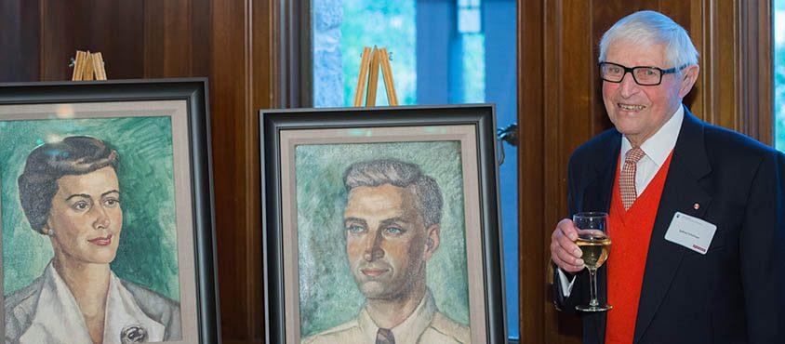
Constance Livingstone & Sydney Freidman
Two of the first appointments to UBC’s Faculty of Medicine, which was founded in 1950.
Established the Department of Anatomy, which was chaired by Sydney Friedman from 1950-1981.
Together published more than 200 papers. Constance Friedman passed away in June 2011 and Sydney Friedman in February 2015.
Foundation supports the Friedman Award for Scholars in Health and the Freidman Travel Award (for Medical Undergraduate Students).
3.3 million endowment to support these programs given in 2016, and another 6 million endowment given in 2017.

Slide 3
Friedman Award for Scholars in Health
The Friedmans believed that a well-rounded and transformative education includes learning from different perspectives and cultures.
Goal: to provide funding to graduate students or medical residents so that they can pursue a learning opportunity to further their career or to bring new perspectives to the education they have already received.
Mission: To extend the global reach of UBC graduate students and UBC medical residents and enrich our scholarly community by providing opportunities for our future scholars in the health sciences to learn from global experts in their respective fields.
Award: Up to $50,000 each will be awarded for six or more months of study. The amount of the award will be at the discretion of the adjudication committee.

Slide 4
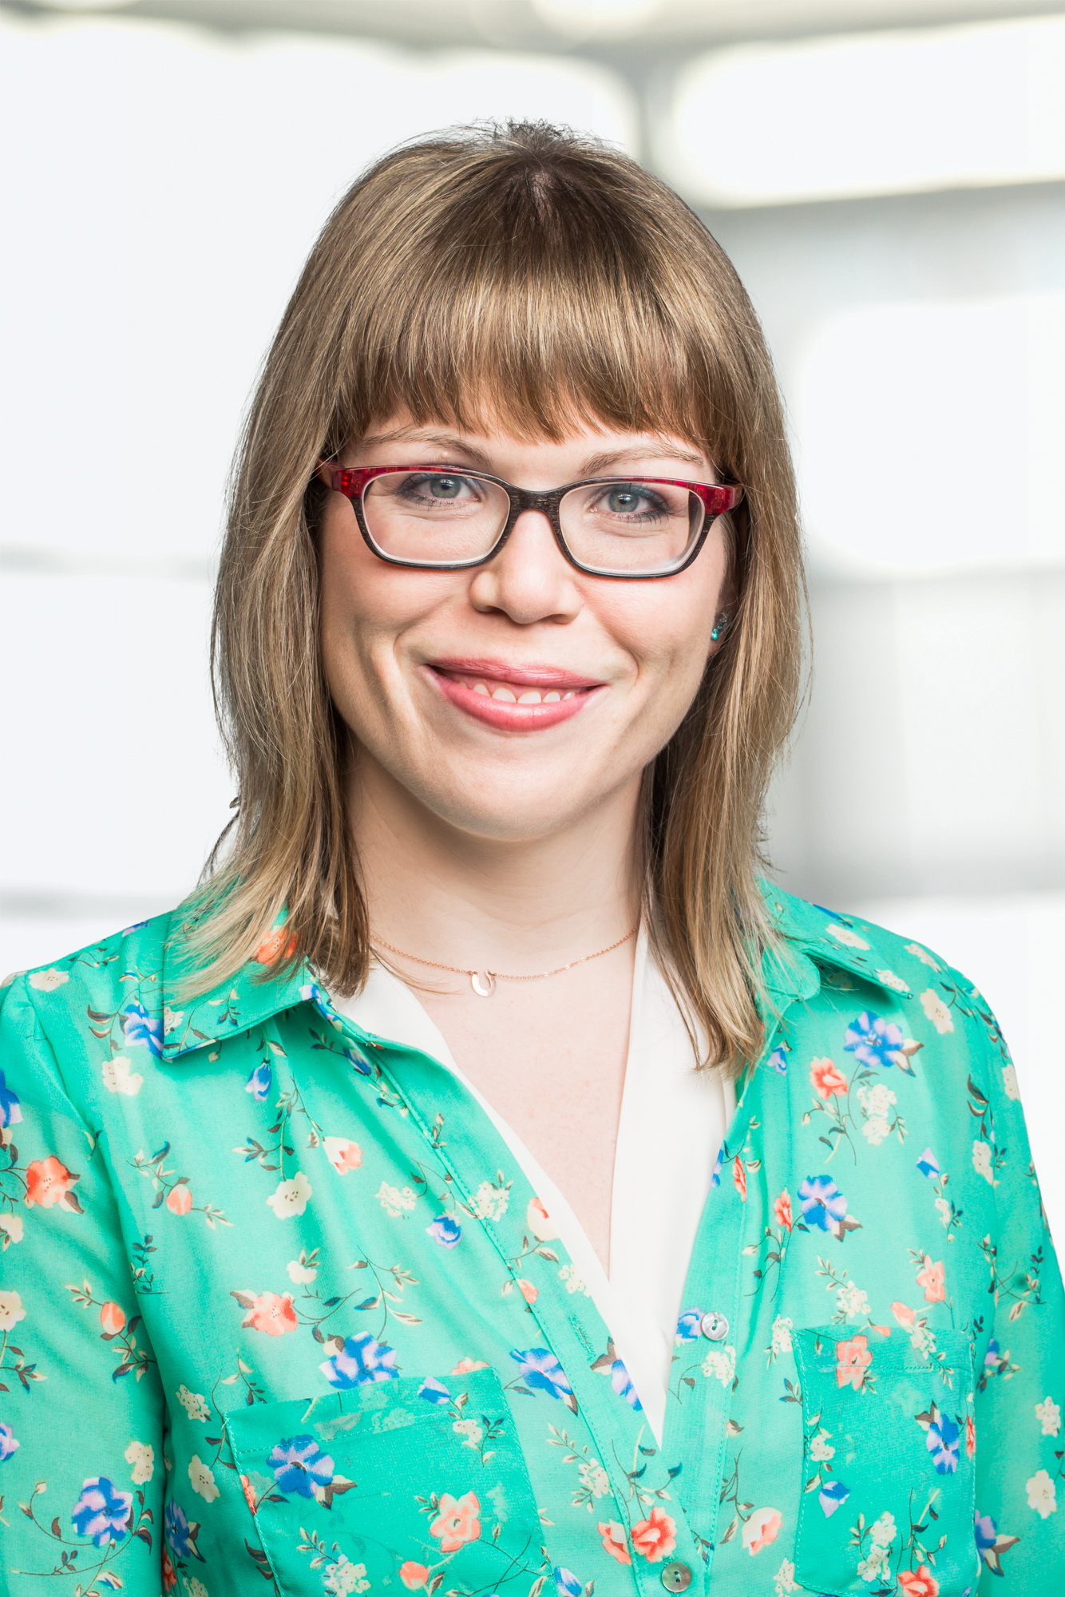
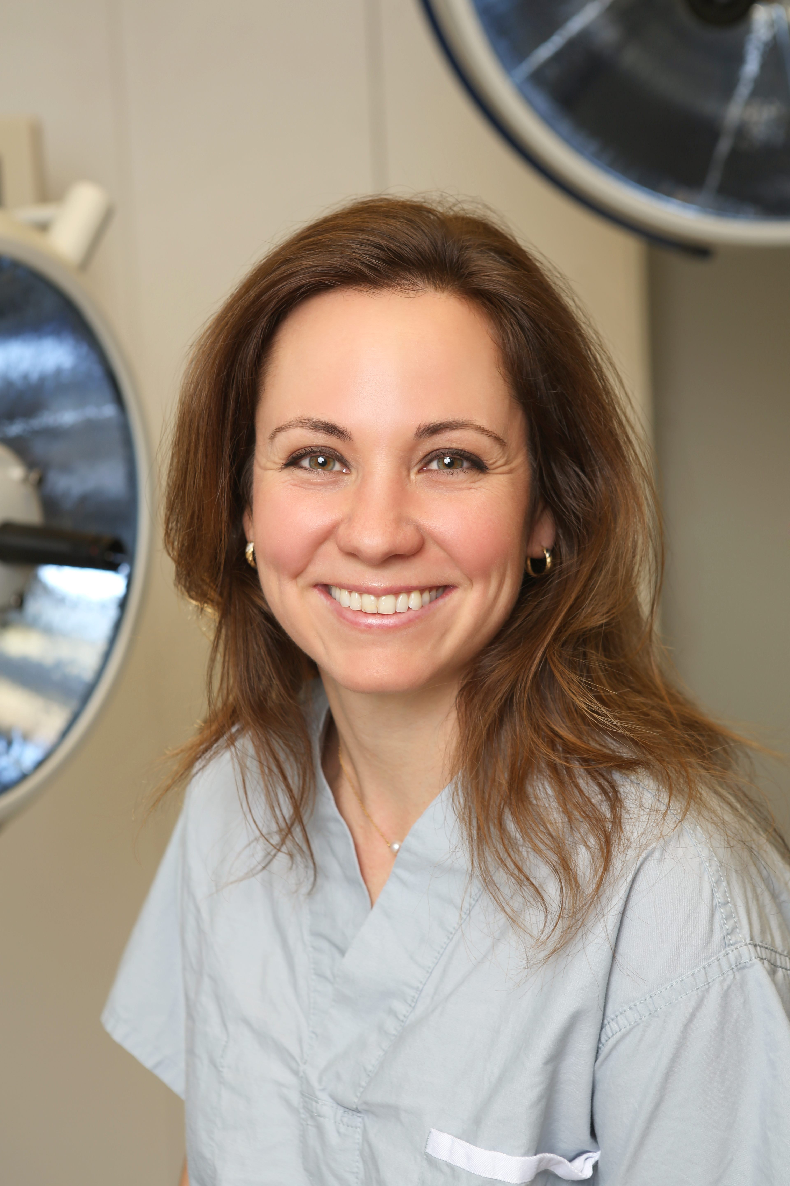
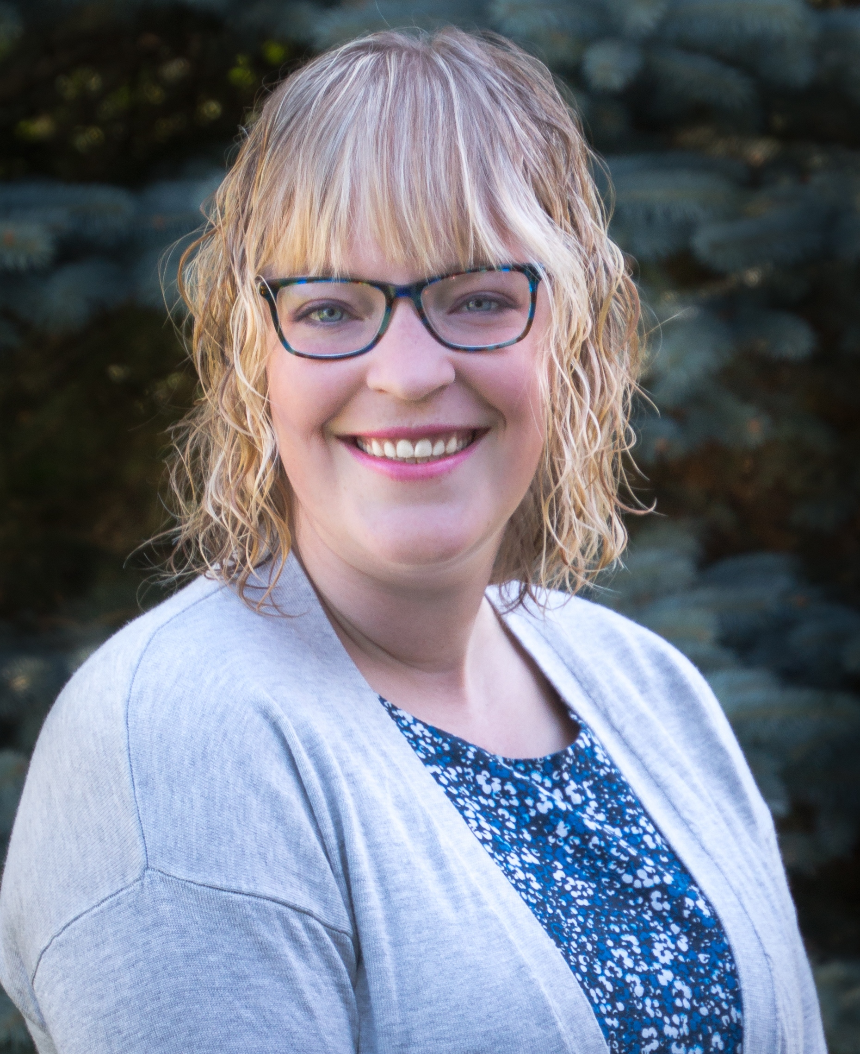
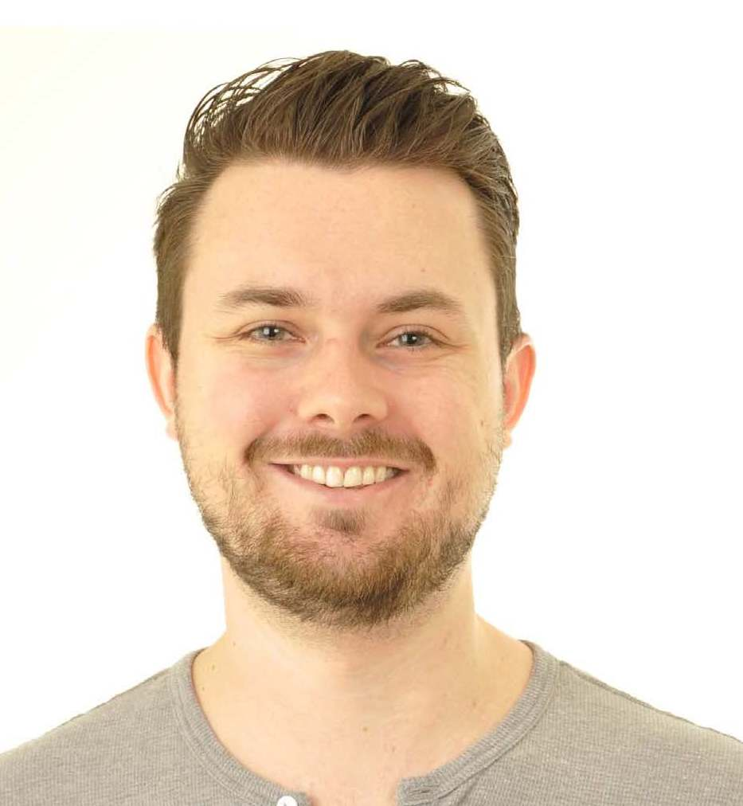
Past Awardees
2017 Friedman Scholar Shahrzad Joharifard is getting a MPH at Harvard, to be then applied to building a surgical program at JJ Dossen, the primary referral hospital in eastern Liberia (USA / Liberia)
2017 Friedman Scholar Melissa Mackenzie is studying movement disorders at Queen’s Square in order to further her work in Parkinson’s Disease (UK)
2017 Friedman Scholar Jordan Squair is developing a non-pharmacological neuroprosthetic device to aid in outcomes following spinal cord injury at the École Polytechnique Fédérale de Lausanne (Switzerland)
2017 Friedman Scholar Kaylee Byers is studying wildlife health surveillance systems and the tracking of emergent zoonotic diseases at the Sri Lanka Wildlife Health Centre (Sri Lanka)

Slide 5
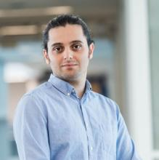
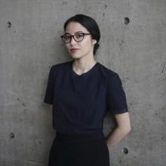
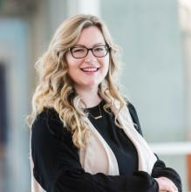
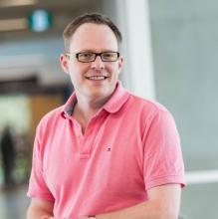
Past Awardees
2018 Friedman Scholar Hooman Esfandiari is developing VR technology uses for spinal procedures
at Ludwig Maximilian University of Munich and the Technical University of Munich (Germany)
2018 Friedman Scholar Raquel Baldwinson is studying Global Health and the Rhetoric of Interdisciplinarity as a Visiting Fellow at Harvard
(USA / Canada / Rwanda)
2018 Friedman Scholar Lindsay Richter is developing evidence-based content related to neonatal health for digital media at Dalhousie University in Nova Scotia (Canada)
2018 Friedman Scholar Andrew Perrin is a medical resident studying how antipsychotic medications impact hippocampal neurogenesis at King’s College, London (UK)

Slide 6
Overview of the Application Process

Slide 7
Key Details
Application deadline: February 22, 2019 at 4pm PST
Value: Up to $50,000
Duration: 6 or more months of study

Slide 8
Application Procedures
Application form
Outline of the educational opportunity (4 pages max)
Description of key personnel, host organization, and their mission and contributions to the broad area of health
Timeline of the opportunity - Include start/end dates and key milestones
Details of the opportunity - Describe the learning environment, learning objectives, specific activities, and expected outcomes
Potential impact of the opportunity on the field of health and on your career and/or personal development

Slide 9
Application Procedures (cont’d)
References/bibliography/citation (1 page max)
Simple budget (1 page max)
Synopsis of your education to date (1 page max)
Letter of support from UBC supervisor (2 pages max)
For graduate students, your UBC research supervisor
For medical residents, your UBC program director
Letter of support from host supervisor (2 pages max)
Email documents as PDF to the Awards department at graduate.awards@ubc.ca

Slide 10
Eligibility - Applicant
Canadians, permanent residents and international students are eligible
Open to Masters and Doctoral students, Medical Residents
Open to applicants studying/researching in the area of health. “Health” is interpreted very broadly, and includes health promotion and disease prevention, mental health research, laboratory sciences etc.
The applicant does not need to be studying in a Health degree. Past award winners have included a PhD candidate in English.

Slide 11
Eligibility – Applicant (cont’d)
Must be a current student/medical resident at UBC as of the application deadline (February 22) – prospective students starting at UBC later in 2019 are not eligible to apply

Slide 12
Eligibility - Opportunity
Acceptable host organizations or groups may include:
Universities
Research centres
NGOs
Private sector companies
Government agencies

Slide 13
Eligibility – Opportunity (cont’d)
Travel must be outside of Western Canada (British Columbia, Alberta, Saskatchewan and Manitoba).
Travel must be for a minimum of 6 months. The six-month time period may be distributed over a longer period (e.g., one year) if circumstances merit it.
Travel must begin no earlier than June 1 of the application year and no later than April 30 of the following year.

Slide 14
Eligibility – Budget Expenses
Funds received from this award are to be used for expenses related to the opportunity. These may include: travel expenses (airfare, visas, health insurance, etc.), living expenses (rent, groceries, etc.), fees assessed for related educational endeavours.
Other kinds of research or project-related expenses should include a justification.
The funds may not be used for expenses already incurred or for UBC tuition. None of the funds shall be used to pay down or reduce current or past educational debt, to pay a personal stipend for the learner, or to pay UBC tuition.

Slide 15
Evaluation Criteria
Student/medical resident’s past accomplishments and future promise
The nature and quality of the learning opportunity
The potential impact of the learning/work opportunity on the field of health

